Slide 1
Preemption and Florida’s 2019 Legislative Session
Case Study presented by
Ida V. Eskamani
Organize Florida +
Statewide Alignment Group

Slide 2
Florida’s 2019 Legislative Session: Case Study
More than 35 preemption bills filed this session; majority did not move. Of those with momentum:
We stopped:
HB 3: Sweeping preemption and repeal of ALL local “business regulation”
SB 432: Preemption of predictive scheduling and wage theft ordinances
HB 1299: Preemption “train” bill with 7+ preemptions combined
We weakened:
SB 168: So-called sanctuary city bill, top priority of Governor
HB 7103: Inclusionary Housing ordinances

Slide 3
Florida’s 2019 Legislative Session: Case Study
Preemption is the key policy issue that impacts every single constituency group. It is unifying force like no other.
Preemption allows corporate interests to circumvent local governments by focusing lobby efforts on small number of lawmakers, centralizing control at state level for profit.

Slide 4
Florida’s 2019 Legislative Session: Case Study
We built and led a cross-issue coalition like no other:
Labor (AFL-CIO, Laborers, Building Trades, SEIU, Jobs with Justice, FEA, AFSCME, Miami Workers Center)
Public Health (Cancer Association, Heart Association)
Immigrant Rights (FLIC, Latino Justice, FLAN)
Civil Rights (SPLC, ACLU)
Environmental (Surf Riders, Florida Conservation Voters, 100 Friends of Florida, etc.)
LGBTQ+ (Equality Florida)
Reproductive Rights (Planned Parenthood, FLAN)
Animal Advocacy (Humane Society, ASPCA)
League of Cities & Association of Counties
LSSC, A Better Balance, and CPD critical partners

Slide 5
Florida’s 2019 Legislative Session: Case Study
We convened every week & coordinated efforts:
Lobby Lawmakers & Leveraged Relationships
Prepared champions with questions, debate, & amendments
Organized Presence in Committee Hearings
Mobilized lobby days and members from across the state
Press and media engagement
Press conferences, releases, ads, etc.
Regional polling in targeted districts
LSSC’s legal analysis, messaging guidance, best practices, and financial support allowed infrastructure that was nimble & efficient

Slide 6
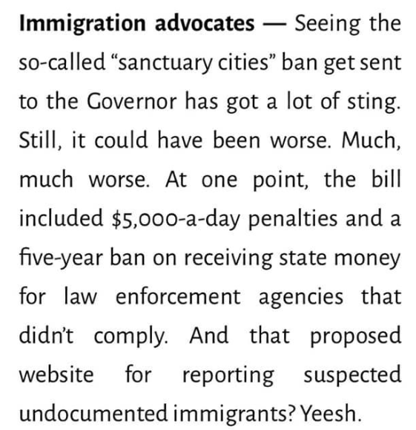
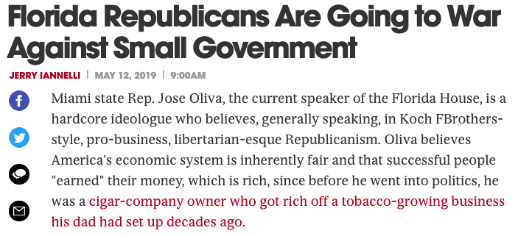
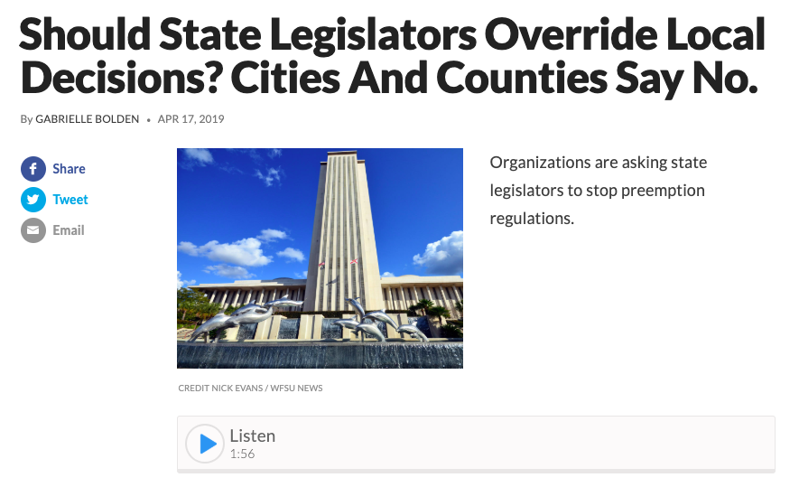
Florida’s 2019 Legislative Session: Case Study

Slide 7
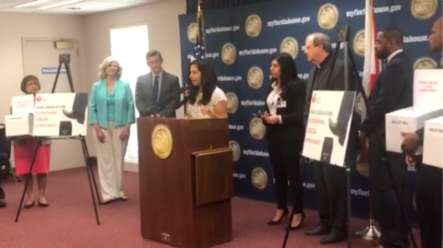
Florida’s 2019 Legislative Session: Case Study
The opposition was not prepared for our coordinated efforts
Many of these fights we have seen before and we will see again
Efforts concentrated on lining pockets of major donors, red meat for their base, and suppressing our turnout.
With a cross-issue coalition, we disrupted their efforts & shifted narrative.

